Slide 1
The Computable News Project Research in the newsroom
Will Radford, Daniel Tse, Joel Nothman, Ben Hachey, George Wright,
James R. Curran, Will Cannings, Tim O’Keefe, Matt Honnibal,
David Vadas, Candice Loxley
The University of Sydney, Fairfax Media,
Capital Markets Cooperative Research Centre

Slide 2
Motivation
Project vision & setup

Slide 3
Most news data is natural language
Unstructured
Text
NLP
Structured
Knowledge

Slide 4
The Computable News project
Structured layer over unstructured text
Australian Government’s Cooperative Research Centre
Capital Markets CRC
The University of Sydney (James Curran)
Fairfax Media (George Wright)
Benefits
Cost sharing
Real research problems
Focussed, time-limited research

Slide 5
Research
Named Entity Linking (Hachey et al., 13; Radford et al, 10-12; Pink et al. 13)
Quotation Extraction and Attribution (O’Keefe, 12-13)
Event Linking (Nothman et al., 12)

Slide 6
Named Entity Linking: text → KB entities
Sports reporter Scott McIntyre to sue SBS
for sacking over Anzac Day tweets
Scott McIntyre (reporter), Special Broadcasting Service, Anzac Day
Extract: named entity recognition, heuristic coreference resolution
Search: search Wikipedia for possible KB entity candidates
Disambiguate: re-rank candidate lists using KB, context and whole document features
Detect NILs: low-scoring entities may not be in our KB
http://www.theguardian.com/media/2015/may/18/sports-reporter-scott-mcintyre-to-sue-sbs-for-sacking-over-anzac-day-tweets

Slide 7
How we use linked entities
Indexing
Index documents by their entities
Co-occurrence relation measures for entities
Associate entities to images via linked captions
Challenges
Ambiguity: ambiguous mentions, entity aliases
KB dynamism: emerging entities, disappearing entities
KB appropriateness: managing local news

Slide 8
Engineering for 25 years of archive
(Mostly) data-parallel
Experimented with database backends
Solr/Lucene
Cassandra
Hypertable
Document-representation format: DOCREP (Dawborn, 14)
Model data once, use often
*NIX pipeline operations

Slide 9
Quotations: who said that?
Mr Brown said “That’s untrue” (direct)
His spokeman said he returned the gift… (indirect)
Different systems
Heuristic baseline
CRF model over speaker IDs
Also: Debate opinion framing

Slide 10
Event linking: text → KB events
Rudd returned to the top job in June after challenging Gillard in a caucus ballot.
More difficult than entities
Identity
Granularity
Formalised as hyperlinking a news archive

Slide 11
Applications
Writing news, researching entities, reading distilled news, curating knowledge

Slide 12
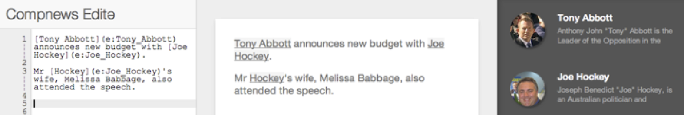
Editor: helping journalists write richer stories
Automatic text augmentation
Entity links [mention]{e:entity_name}
Knowledge
{partner}→ Melissa Babbage
{age} → 48 years old
{map} → coodinates + maps.google.com
Idea: recreate a NER/NEL corpus every week

Slide 13
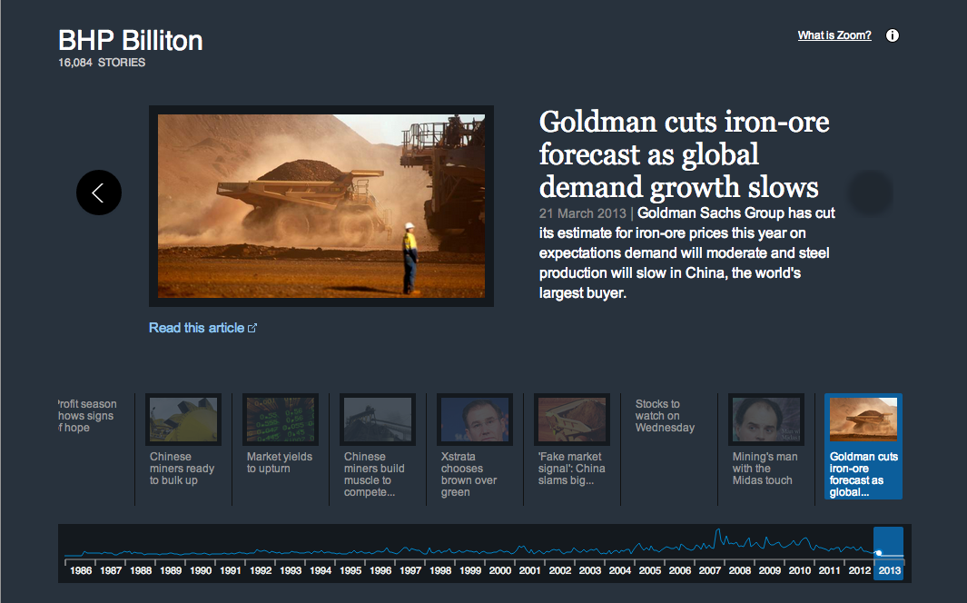
Zoom: accessing the archive though entities
Landing page for each entity
Images and snippets
Mention frequency timeline
Which stories do we show?
Idea: drive traffic deeper into the archive

Slide 14
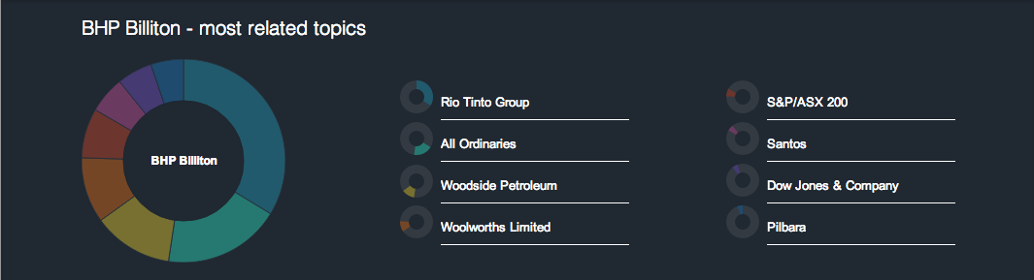
Zoom: accessing the archive though entities
Balance commonness with surprise
Idea: simulate the “lost in Wikipedia” experience

Slide 15
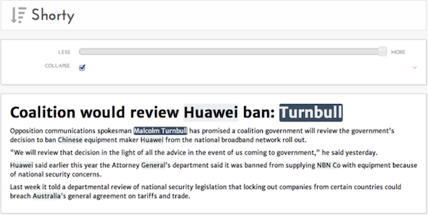
Shorty: summarising stories
Baseline extractive summarization
Slide to reveal more
Idea: use coreference chains to repair sentences

Slide 16
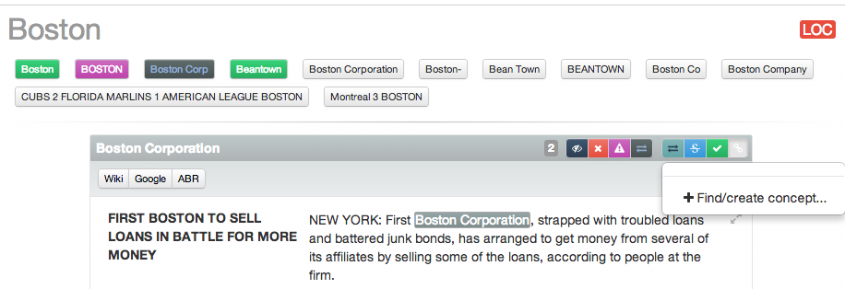
Correction: maintaining the KB
Fix mention errors in batch or individually
Add new entities as they become newsworthy
Open question: how much do you fix?

Slide 17
Discussion
What we learned

Slide 18
What the researchers learned
Shared task participation is useful (i.e. TAC KBP)
Demonstrations to business > table of figures
80% still means 1 in 5 wrong
Forgivable errors != stupid errors
Time spent engineering is mostly well spent

Slide 19
What the business learned
From users
Zoom is good for topic-driven news, not for breaking news
Journalists like doing less work, exploring related entities
Editorial staff likes analytics: internal and external

Slide 20
Conclusion
Overview of:
Entity-centric news research programme
Wide range of applications
What’s Fairfax doing now?
Early bets on research have increased data literacy
“Future Services” has become “Intelligent Systems”

Slide 21
Thanks for listening.
Questions?

Slide 22
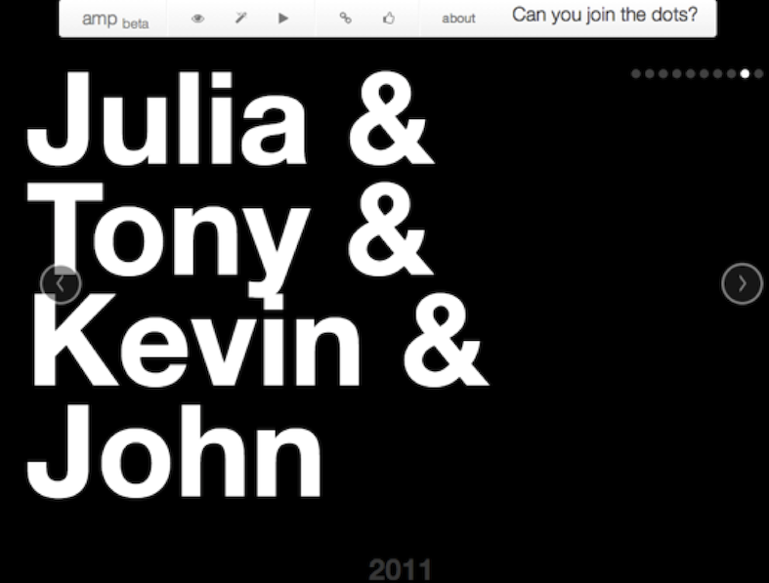
Amp: news trivia games
Show first names of related people
Guess the last names
Idea: KB-sized games, what could you do with feedback?

Slide 23
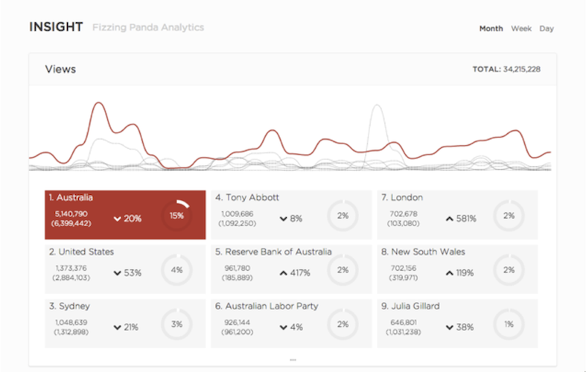
Insight: supporting editorial
What entities do people:
read about
share
Open question: how much should analytics drive editorial?

